Slide 1
Project 02: Gaussian and bilateral filters
Team Members
Jogalekar, Aditya : 3189939
Morbagal ,Tejas : 3200842
Rajan Heena : 3205531
Khan, Saba : 3179769
Kochar, Pratika : 3201097
Shetty. Sachin : 3201423
Malik, Hirra : 3212661

Slide 2
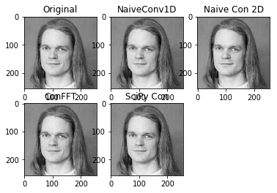
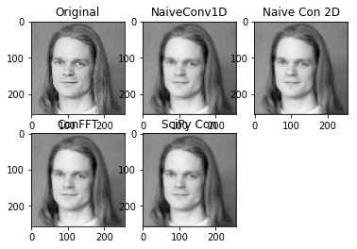

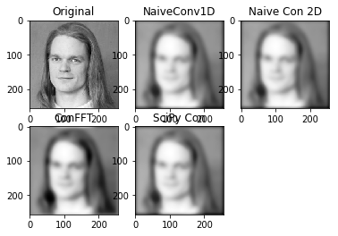
TASK 2.1.1: All operations
Kernel: 3x3, sigma=.388
Kernel: 7x7, sigma=1.165
Kernel: 19x19, sigma=3.495
Kernel: 31x31, sigma=5.825

Slide 3
For a kernel size: 25x25, sigma=4.660
('Time-naive_convolution1D: ', 5.38100004196167)
('Time:naive_convolution2D ', 104.2039999961853)
('Time:fft_convolution ', 0.014999866485595703)
('Time: ScipyCon ', 0.04699993133544922)
For a kernel size: 37x37, sigma=6.990
('Time-naive_convolution1D: ', 8.134000062942505)
('Time:naive_convolution2D ', 231.08500003814697)
('Time:fft_convolution ', 0.018999814987182617)
('Time: ScipyCon ', 0.11999988555908203)
For a kernel size: 29x29, sigma=4.660
('Time-naive_convolution1D: ', 8.134000062942505)
('Time:naive_convolution2D ', 231.08500003814697)
('Time:fft_convolution ', 0.018999814987182617)
('Time: ScipyCon ', 0.11999988555908203)
For a kernel size: 39x39, sigma=7.379
('Time-naive_convolution1D: ', 8.075999975204468)
('Time:naive_convolution2D ', 247.22000002861023)
('Time:fft_convolution ', 0.015000104904174805)
('Time: ScipyCon ', 0.14100003242492676)

Slide 4
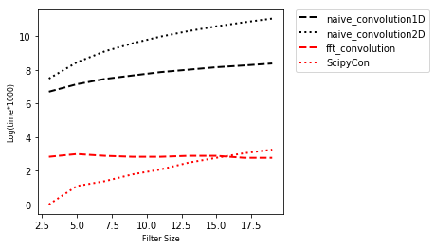
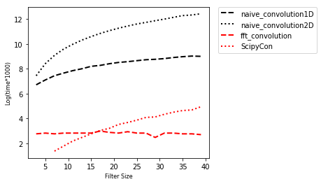
Time Plots: Couple of examples
19x19 kernel size time
39x39 kernel size time

Slide 5
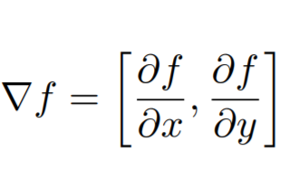
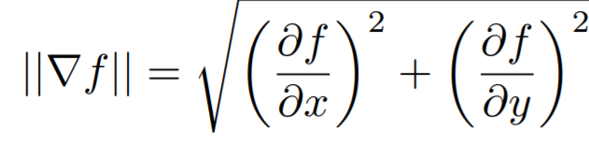
TASK 2.2 : COMPUTING THE GRADIENT OF IMAGES
Gradient of a image is the measure of change in the image function f(x,y) in
X (columns)and Y (rows) axis.
Mathematically it is defined as:
Gradient Magnitude gives us the edge strength

Slide 6
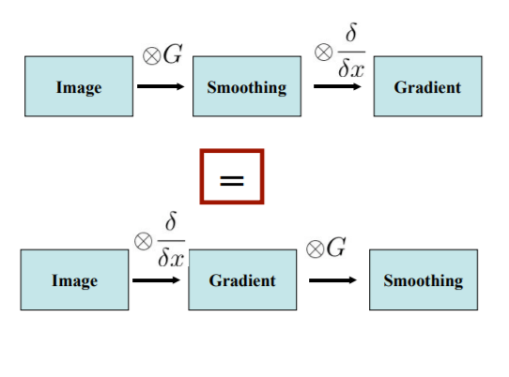
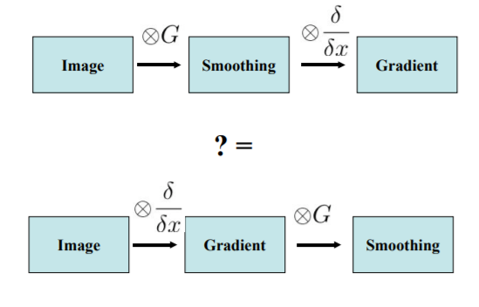
When computing gradient images, it is beneficial to apply the gradient operator to a smoothed version of the input image in order to ensure robustness against noise.
Can we switch image smoothing and image differencing?
Yes

Slide 7
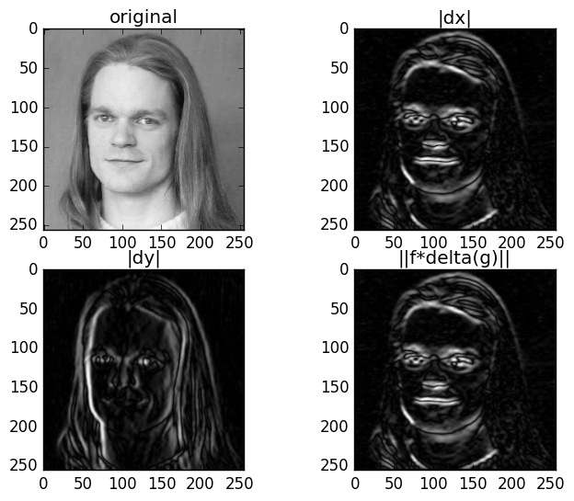
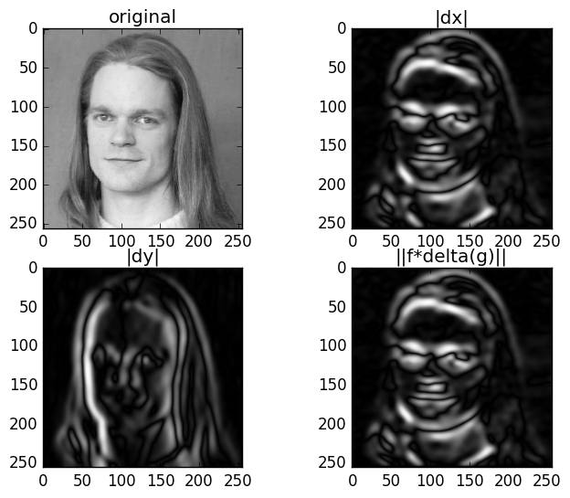
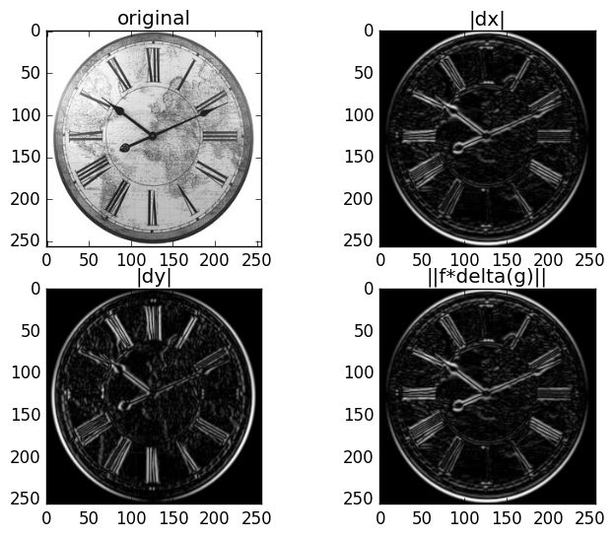
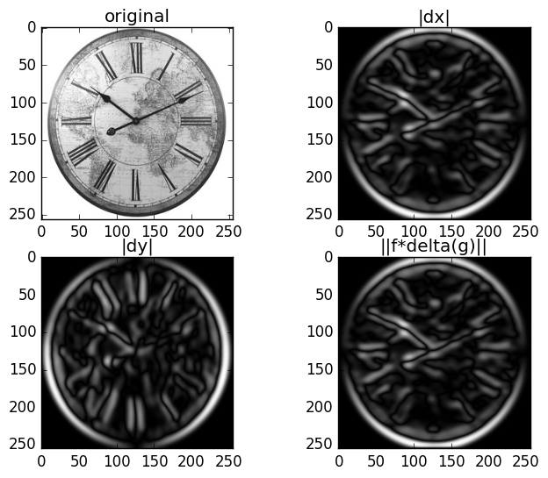
RESULTS:

Slide 8
OBSERVATIONS:
A larger file size, corresponds to a larger convolution mask and will result in a greater degree of filtering.
As a kind of trade-off for greater amounts of noise reduction, larger filters also affect the details quality of the image.

Slide 9
Recursive function for Gaussian Image Smoothing
Task 2.3 A Recursive filter for Gaussian image smoothing
Computes smoothing of an image by convolution with the Gaussian kernels
Implemented as IIR filters
Works on each component independently
Input and output need to be the same type

Slide 10
Causal Filter
Linear and time invariant
Recursion from right to left
Filter output depends only on past and present inputs
Realization systems must be causal because such systems cannot act on a future input.
Anti Causal Filter
Hypothetical system
Outputs and internal states that depend solely on future input values
Also acausal, but the converse is not always true. An acausal system that has any dependence on past input values is not anticausal.

Slide 11
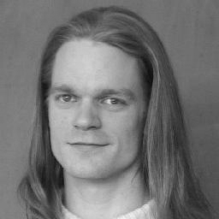
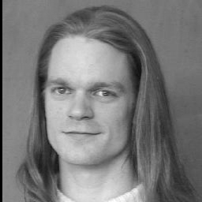
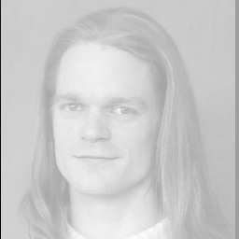
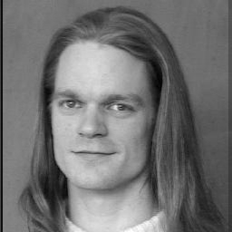
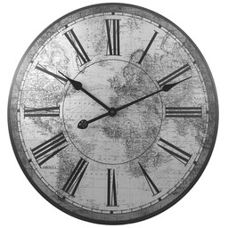
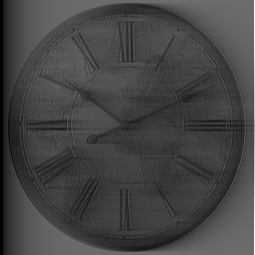
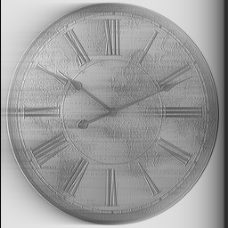
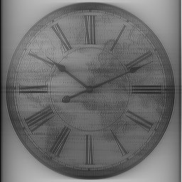
Results
Original Image
Causal Filtered Image
Anti-Causal Filtered Image
Smoothened Image

Slide 12
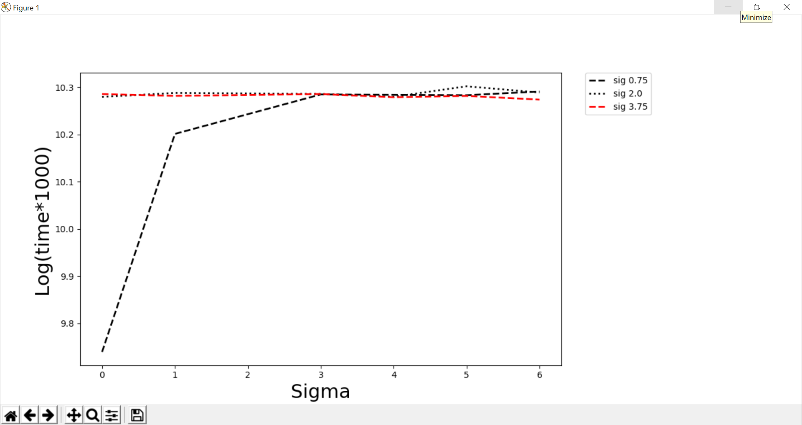
Results

Slide 13

Task 2.4 Bilateral filters
A bilateral filter is a non-linear, edge-preserving, and noise-reducing smoothing filter for images. It replaces the intensity of each pixel with a weighted average of intensity values from nearby pixels. This weight can be based on a Gaussian distribution. Crucially, the weights depend not only on Euclidean distance of pixels, but also on the radiometric differences (e.g., range differences, such as color intensity)

Slide 14
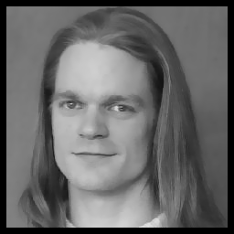


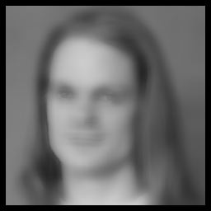


Bilateral Filter on bauckhage.jpg Filter size = 15
ρ = 10, σ = 2
ρ = 10, σ = 100
ρ = 100, σ = 2
ρ = 100, σ = 100
ρ = 500, σ = 2
ρ = 500, σ = 100

Slide 15
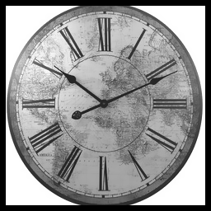


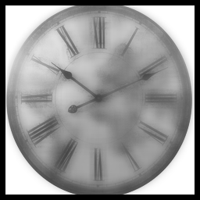


Bilateral Filter on clock.jpg Filter size = 15
ρ = 10, σ = 2
ρ = 10, σ = 100
ρ = 100, σ = 2
ρ = 100, σ = 100
ρ = 500, σ = 2
ρ = 500, σ = 100

Slide 16
Observations
Bilateral filter can keep edges sharp while blurring image.
A larger value of the parameter ρ means that farther colors within the pixel neighborhood will be mixed together, resulting in larger areas of semi-equal color.
A larger value of the parameter σ means that farther pixels will influence each other as long as their colors are close enough.

Slide 17
THANK YOU

